Slide 1
Song of Moses & the Lamb
Difficult Leadership Lessons from Deuteronomy

Slide 2
How to Think about Herem Warfare as a Christian
Let the text trouble you. (Ezek 18:23-24)
Recognize YHWH’s right to judge and expect him to judge justly (cf. Gen. 18:25)
Remember the context of YHWH’s whole relationship with the Canaanites (Gen. 9:20-26; 15:13-16; 19:23-29; Josh 2, 6)
Remember ways in which YHWH mitigated loss of life (Exod. 23:27-31; Lev. 18:24-28; Num 33:51-56; Dt. 4:37-38; 6:18-19)
View in the light of the OT’s larger theology of warfare (Deut. 17; 20)
Exaggerated nature of conquest rhetoric in ancient Near East
N.B. Jesus’ answer/response to the Canaanite threat (Matt. 15:21-28)

Slide 3
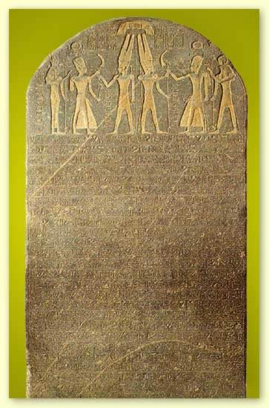
Merneptah Victory Stele (1231 BC)
The princes are prostrate saying: "Shalom!" Not one of the Nine Bows lifts his head: Tjehenu is vanquished, Khatti at peace, Canaan is captive with all woe. Ashkelon is conquered, Gezer seized, Yanoam made nonexistent; Israel is wasted, bare of seed, Khor is become a widow for Egypt. All who roamed have been subdued. By the King of Upper and Lower Egypt, Banere-meramun, Son of Re, Merneptah, Content with Maat, Given life like Re every day.

Slide 4
Restricted Access to YHWH’s Assembly

Slide 5
Defining and Protecting YHWH’s Assembly
What is YHWH’s assembly? All adult males who are qualified to:
make decisions
engage in cultic activities (i.e. worship)
serve in Israel’s military
Cf. Micah 2:5
Generally speaking this is an inclusive assembly (cf. 12:7, 12; 16:11, 14)
Restrictions are here for the first time mentioned
Who is prohibited?
Emasculated males
Those born of prohibited unions
Ammonites & Moabites (note both people groups arose from incestuous relationships cf. Gen. 19 and born to a man who dishonored Abraham. His descendants follow suit and are not rightly related to the point of contact with divine blessing cf. Num 23-24; 31:16)
What is the point? Sanctity of the assembly, to impress upon Israel the care with which one must enter the divine presence (cf. Psalm 15)
The point is NOT that there is no admittance to such people but that their point of entry is necessarily different than Israel’s AT THIS POINT IN REDEMPTIVE HISTORY

Slide 6
Remarkable Reversals
Isaiah’s anticipation of YHWH’s removal of restrictions on the assembly (Isa 56:3-8)
The Ethiopian eunuch (Acts 8:26-40)
Ruth’s inclusion in Israel
Jer. 49:6 anticipates a future for Ammon among God’s people
Why make these restrictions only to repeal them later? Israel is in her infancy and is very vulnerable to the nations’ influence and corruption.
This will not always be the case!

Slide 7
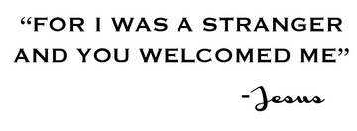

Slide 9
Moses’ Bucket List
Enter the Promised Land

Slide 10
Disappointed with God’s Severity
Importance of the death of Moses to the Book of Deuteronomy
The death of Moses frames Deuteronomy (1:37; 34:1-12)
The death of Moses punctuates Deuteronomy (Dt. 3:23-27; 4:21-22; 18:15; 31:2, 14-16, 27-29 )
The death of Moses is the key object lesson in Deuteronomy (Moses as model 3:23-27; 31:7-8; 34:6)

Slide 11
Moses as Model
Of submission to divine discipline (3:23-27)
Of dying to personal dreams for the greater good and handling the disappointment graciously
Of refusing to compete either with God’s honor or the success of the leadership replacing him (31:1-6; 34:6)
Of self-sacrificial mediation (Exod 32:31-35)

Slide 12
Delighted with God’s Sensitivity
Who buried Moses?
YHWH did!!
Prevention of the rise of a personality cult – Moses’ grave could not become a shrine
A tender act of familial love that lays to rest any doubts regarding YHWH’s regard for Moses
He does not subject Moses to covenant curse (Dt. 28:26)
He claims Moses as family by taking responsibility for his burial (Gen. 23:19; 25:9-10; 50:4-6)

Slide 13
Dumbfounded by God’s Ultimate Salvation
God’s dissatisfaction with end of Deuteronomy evident in the gospels
Jesus, Moses, and Elijah on the mountain where Jesus was transfigured
Where is Moses when he appears before transfigured Jesus?
IN THE PROMISED LAND!!
The two requests Moses made of YHWH while alive on earth that were denied are finally granted in Christ!
Who needs a bucket list when you can have eternal life? (John 11:25-26)

Slide 14
Leadership in Deuteronomy
Beware of stagnation (1:6; 2:3)
Development and delegation (1:9-18)
Beware of bitterness toward the people you lead (Dt 1:37; 3:26; 4:21)
Leadership, at its heart, is intercessory and mediatory, being the first to approach God and modeling spiritual intimacy (Dt 5:23-27)
Judges Dt 16
Kings Dt 17
Priests Dt 18
Prophets Dt 18

