Slide 1
From the Bizarre to the Barbaric
Why Deuteronomy is Difficult for Christians

Slide 2
What Can We Expect Deuteronomy to Teach Us?
How to love God with our whole being (Deut 6:4-5)
Love as defined by God is about devotion and fidelity
Love paired with fear in Deut 10:12-13
Divine love seeks our good always (Deut 6:24; 10:13; )
Human love of YHWH seeks YHWH’s honor always (Deut 5:7-11, 16; 8:5; Mal 1:6-8)
How to introduce succeeding generations into YHWH’s covenant (Deut. 6:7-21)
How to structure and live within a community centered around God (Deut. 12 – 24)
What constitutes good spiritual leadership (Deut 1:13-15; 17:14-20; 34:9-12)
How to draw the nations to the God who revealed himself in Jesus (Deut. 4:5-8)

Slide 3
Huffington Post THE BLOG 10/29/2014 10:09 am ET Updated Dec 29, 2014
The No. 1 Reason Teens Keeps the Faith as Young Adults
By David Briggs
The holy grail for helping youth remain religiously active as young adults has been at home all along: parents.
Mothers and fathers who practice what they preach and preach what they practice are far and away the major influence related to adolescents keeping the faith into their 20s, according to new findings from a landmark study of youth and religion.
Just 1 percent of teens ages 15 to 17 raised by parents who attached little importance to religion were highly religious in their mid-to-late 20s.

Slide 4
The Removal From the Gates
Supreme court’s ruling regarding displays of the ten commandments.
Our response?
imprint them on our children’s hearts
Culture war vs. culture care
Deuteronomy clearly identifies the home as the primary place and the parents as the primary agents of spiritual formation.
Recent article in the Huffington Post 10/29/2014

Slide 5
Deuteronomy & Cognitive Dissonance
CD = deeply unsettling and uncomfortable tension between long held assumptions and fresh encounters with reality that force fundamental shifts in our thinking and behavior.
Juxtaposition of profound and enlightened demonstrations of compassion and concern for justice and equity with disturbing demonstrations of violence and exclusion
Protection of runaway slaves, preoccupation with preservation of human life, creation care (Deuteronomy 20:19; 22:1-8; 23:15)
Canaanite purge, communal participation in capital punishment even of family members, exclusion of disabled individuals from worship assembly, apparent prejudice against certain people groups (Deuteronomy 7:1-5; 13:6-11; 23:1-6)
Juxtaposition of remarkably relevant prescriptions with bizarre, arcane dictates
Prohibition against allowing/encouraging gender confusion via cross-dressing (Deut 22:5)
Bizarre dietary restrictions, prohibition against wearing clothes of mixed fabrics, prohibition against boiling baby goat in its own mother’s milk (Deut 14:3-21; 22:11)

Slide 6
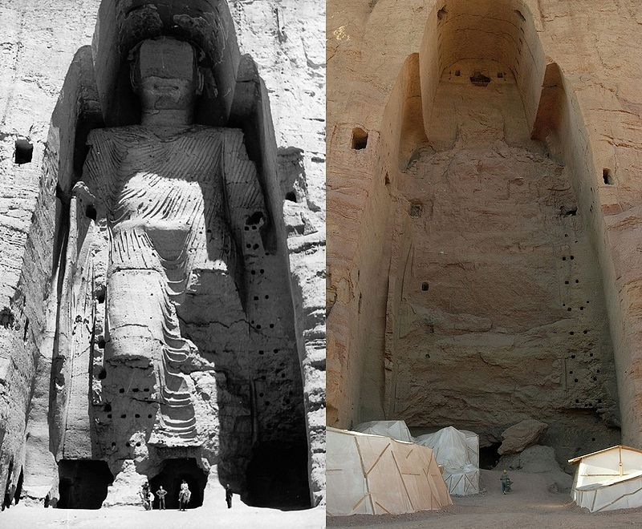
Bamiyan Buddha, Afghanistan
Before the
Taliban
After the
Taliban
Dt. 7:5, 25

Slide 7
How to Think about Herem Warfare as a Christian
Let the text trouble you. (Ezek 18:23-24)
Recognize YHWH’s right to judge and expect him to judge justly (cf. Gen. 18:25)
Remember the context of YHWH’s whole relationship with the Canaanites (Gen. 9:20-26; 15:13-16; 19:23-29; Josh 2, 6)
Remember ways in which YHWH mitigated loss of life (Exod. 23:27-31; Lev. 18:24-28; Num 33:51-56; Dt. 4:37-38; 6:18-19)
View in the light of the OT’s larger theology of warfare (Deut. 17; 20)
Exaggerated nature of conquest rhetoric in ancient Near East
N.B. Jesus’ answer/response to the Canaanite threat (Matt. 15:21-28)

Slide 8
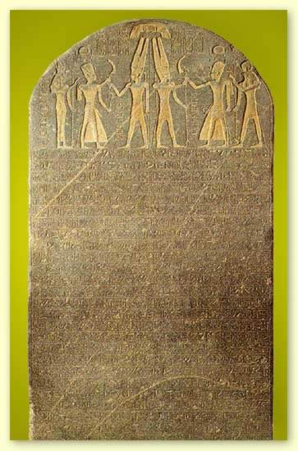
Merneptah Victory Stele (1231 BC)
The princes are prostrate saying: "Shalom!" Not one of the Nine Bows lifts his head: Tjehenu is vanquished, Khatti at peace, Canaan is captive with all woe. Ashkelon is conquered, Gezer seized, Yanoam made nonexistent; Israel is wasted, bare of seed, Khor is become a widow for Egypt. All who roamed have been subdued. By the King of Upper and Lower Egypt, Banere-meramun, Son of Re, Merneptah, Content with Maat, Given life like Re every day.

Slide 9
International Coastal Hwy
“They said in the presence of his majesty, ‘What is it like to go on this [Megiddo] road? Will not horse have to go after horse? Will not our vanguard be fighting [at Megiddo] while the rear guard is waiting here in Aruna, unable to fight? Now there are two other roads. One . . . is east of us, coming out at Taanach. The other comes out to the north of Megiddo.”
Annals of Thutmose III, 15th Century

Slide 10
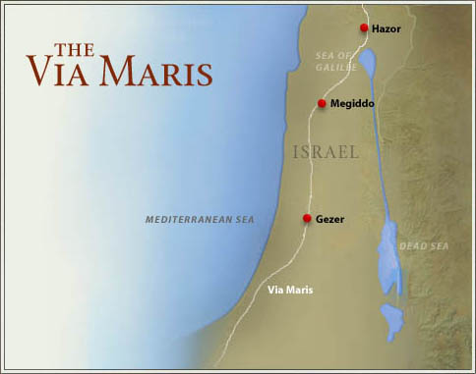

Slide 11
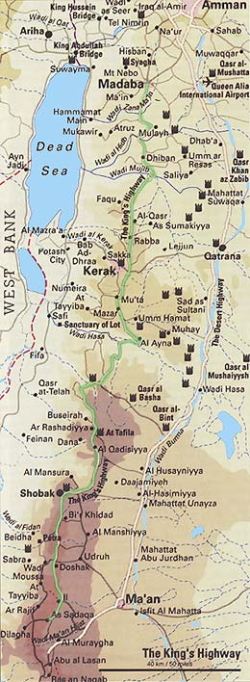
The King’s Highway

Slide 12
Missiological Implications of Land
Main thoroughfare/land bridge from Egypt to Mesopotamia
Exporting Canaanite culture (Canaanite pantheon worshipped at Carthage from 814 BC on!!)
Entry point from Mediterranean (Joppa)
Megiddo – one of the great battlefields of the world
Ideal location for international influence
Perspective relative to conquest and herem warfare?

Slide 13
The Bold and shocking imperative of Psalm 47
Clap your hands, all you peoples;
shout to God with loud songs of joy.
2 For the LORD, the Most High, is awesome,
a great king over all the earth.
3 He subdued peoples under us,
and nations under our feet.
4 He chose our heritage for us,
the pride of Jacob whom he loves. Selah

Slide 14
The Bold and shocking imperative of Psalm 47
Psa. 47:5 God has gone up with a shout,
the LORD with the sound of a trumpet.
6 Sing praises to God, sing praises;
sing praises to our King, sing praises.
7 For God is the king of all the earth;
sing praises with a psalm.
Psa. 47:8 God is king over the nations;
God sits on his holy throne.
9 The princes of the peoples gather
as the people of the God of Abraham.
For the shields of the earth belong to God;
he is highly exalted.

Slide 15
Restricted Access to YHWH’s Assembly

Slide 16
Defining and Protecting YHWH’s Assembly
What is YHWH’s assembly? All adult males who are qualified to:
make decisions
engage in cultic activities (i.e. worship)
serve in Israel’s military
Cf. Micah 2:5
Generally speaking this is an inclusive assembly (cf. 12:7, 12; 16:11, 14)
Restrictions are here for the first time mentioned
Who is prohibited?
Emasculated males
Those born of prohibited unions
Ammonites & Moabites (note both people groups arose from incestuous relationships cf. Gen. 19 and born to a man who dishonored Abraham)
What is the point? Sanctity of the assembly, to impress upon Israel the care with which one must enter the divine presence (cf. Psalm 15)
The point is NOT that there is no admittance to such people but that their point of entry is necessarily different than Israel’s AT THIS POINT IN REDEMPTIVE HISTORY

Slide 17
The Emasculated
Perhaps performed in imitation of the Phoenician deity Eshmun.
Bodily mutilations in general were prohibited due to association w/ Canaanite religion (cf. Lev. 19:28; 21:5)
Mutilated priests and sacrifices prohibited as well (21:20; 22:24)
Many possible reasons
To affirm the goodness of the created order
To discourage pagan practices
To encourage participation in Abrahamic promise
Remarkable reversals
Isa. 56:8 – the ban appears to be lifted. Why?
God working towards new creation (Isa. 42:9; 43:19; 48:6; 65:17)
The Ethiopian Eunuch (Acts 8)
Why prohibit these classes of people only to reverse it later?
Israel’s formative period emphasizing election and sanctity

Slide 18
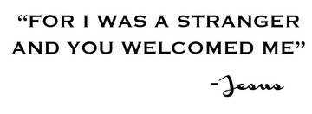

Slide 19
Prohibited Unions, Ammonites & Moabites
Strongly discourage inappropriate unions (Lev. 18)
Moabites & Ammonites mistreated Israel
Failure to help Israel on her way – rejecting right relationship to the point of contact with divine blessing
The attempt to overturn God’s blessing through divination (Balaam) followed by the attempt to seduce Israel (Num 23-24; 31:16)
A fulfillment of Abrahamic covenant
The promise to bless whoever blesses Abraham’s descendants
The promise to curse whoever curses Abraham’s descendants
The idea is to be rightly related to the point of contact with divine blessing
The emphasis on YHWH’s special love for his people – how to understand this in the light of YHWH’s universal love (cf. Mal. 1
Remarkable reversals
Ruth
David
What does this tell us about the way Israel was taught to read the Torah?

